Slide 1


Slide 2
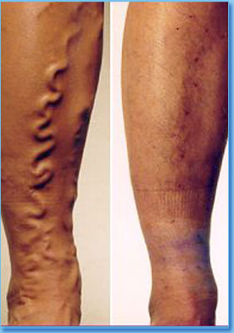
CHRONIC VENOUS INSUFFICIENCY-
Varicose veins
Vishnu Narayanan M.R

Slide 3
CVI-DEFINITION
  Medical condition where veins cannot pump enough deoxy blood back to the heart
  “impaired musculovenous pump”
  Mainly in a)Legs
  b)CNS
  c)Liver

Slide 4
CVI in legs
Includes
Telangectasias
Reticular veins
Varicose veins

Slide 5
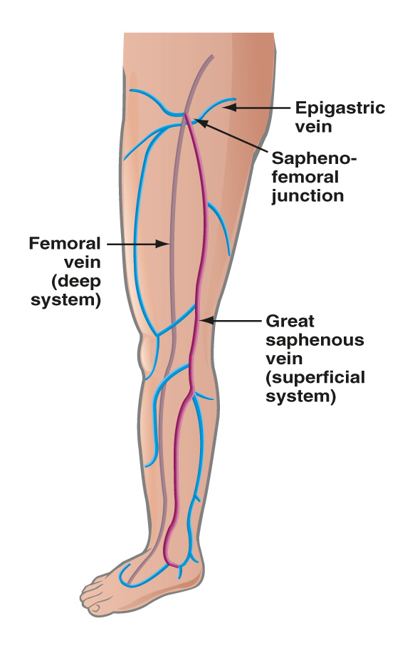
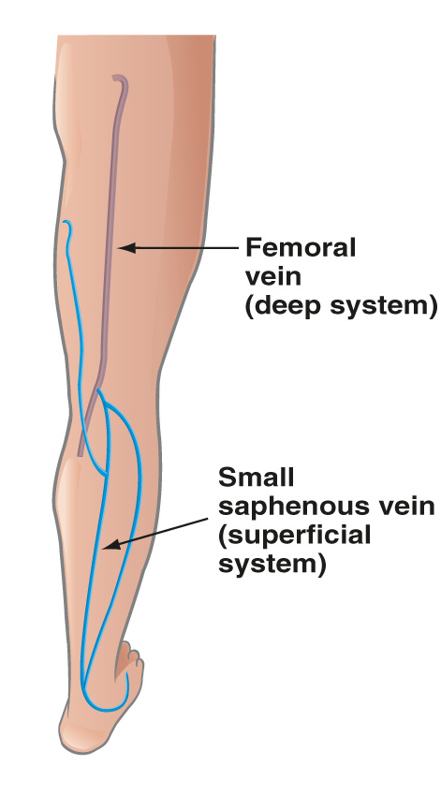
Leg Vein Anatomy
The venous system is comprised of:
  Deep veins
  Superficial veins
  Perforator veins
VN20-03-B 10/04
Notes:
Notes:
Deep veins are highlighted in grey and superficial veins are in blue and pink

Slide 6
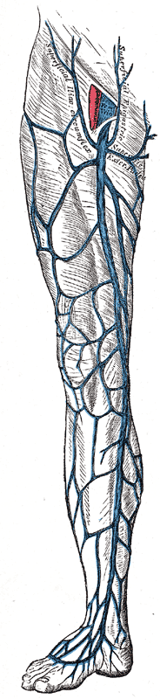
Superficial veins
Great saphenous vein
Begins from medial marginal vein on the dorsum of foot
Ascends in front of tibial malleolus
In the medial aspect of leg(related to???)
behind medial condyles of tibia and femur
posteromedial surface of the knee
In anteromedial aspect of thigh
Terminates into femoral vein at fossa ovalis
2.5cm below and lateral to pubic tubercle

Slide 7
TRIBUTARIES
Ankle-medial marginal vein
Leg-anastomose with SSV
communication-ant.& post.tibial veins
receives post. & ant.arch veins
Thigh-communicate with femoral vein
receives accessory saphenous vein and other cutaneous veins
Fossa ovalis-superficial epigastric vein
superficial iliac circumflex
superficial external pudental vein

Slide 8

Short saphenous vein
Begins from the lateral marginal vein behind lateral malleolous
Lateral margin of tendocalcaneous
Posterolateral aspect of calf
Perforates the deep fascia of poppliteal fossa
Empties into popliteal vein
Tributaries
Superficial circumflex vein,superficial inferior epigastric,ant.vein of leg,post.arch vein
Long intersaphenous communicating vein(comm.vein of Giacomini Cruveilhier)
Ant.accesory great saphenous vein

Slide 9
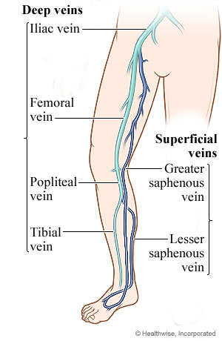
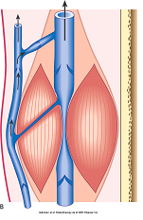
Deep veins
Veins of conduits
Pumping veins/peripheral heart-soleal venous sinus
gastronemial venous
sinus of Gilot
within the deep fascia
Blood flow in greater pressure and volume
Accounts for 80 -90% venous return

Slide 10
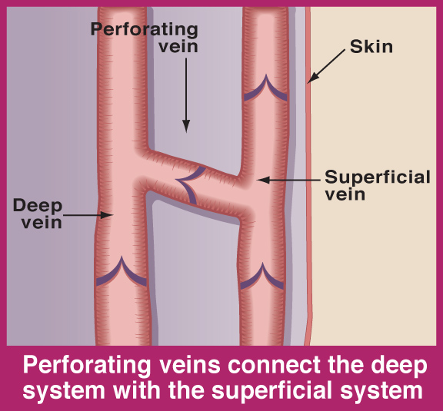
Perforators
Perforating veins connect the deep system with the superficial system
They pass through the deep fascia
Guarded by valves-unidirectional flow from superficial to deep veins
VN20-03-B 10/04

Slide 11
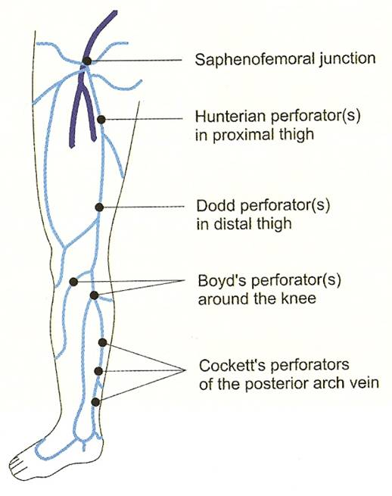
Types of perforators
Ankle perforators-may or kuster
Lower leg perforators of cockett-I,II,III
a)Posteroinferior to med malleolus
b)10cm above med.malleolus
c)15cm above med.malleolus
Gastrocnemius perforators of Boyd
Mid thigh perforators of Dodd
Hunter’s perforator in thigh

Slide 12
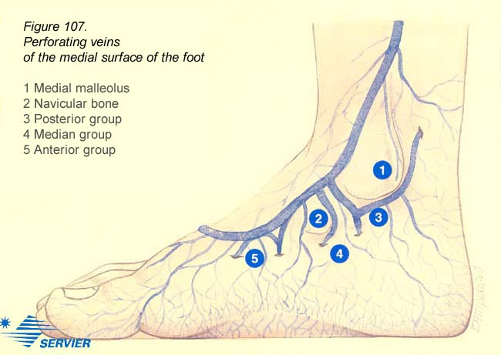

Slide 13
Physiology of venous blood flow
Venous return from leg is governed by
Arterial pressure
Calf musculovenous pump
Gravity
Thoracic pump
Vis a tergo of adjoining muscles
Valves in veins

Slide 14
Musculovenous Pump
Foot and calf muscles act to squeeze blood out of deep veins.
One way valve allow only upward and inward flow.
During muscle relaxation blood is drawn inward thru perforating veins.

Slide 15
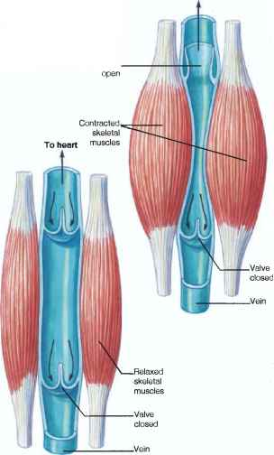
Venous valvular function
Valve leaflets allow unidirectional flow upward or inward.
“nonrefluxing of valves”
Major valves-ostial valve
preterminal valve

Slide 16
Pathophysiology of CVI
Primary muscle pump failure
Venous obstruction
Venous valvular incompetance
1.perforator incompetence-hydrodynamic reflux
2.sup.vein incompetence- hydrostatic reflux
3.deep vein incompetence- isolated/2°

Slide 17
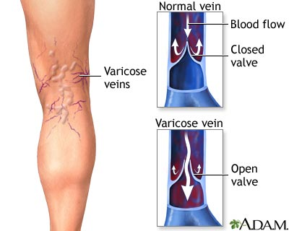

Slide 18
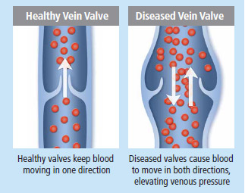

Slide 19
ANY RISK FACTOR INCREASED VENOUS PRESSURE
DILATION OF VEIN WALLS
STRECHING OF VALVES-VALVULAR INCOMPETENCE
REVERSAL OF BLOOD FLOW
FAILURE OF MUSCLES TO PUMP BLOOD
VEINS DISTEND,ELONGATE,TORTOUS,POUCHED,INELASTIC
AND FRIABLE

Slide 20
Telangectasias
Small(0.5-1mm) widened blood vessels in skin-small intradermal varicosities
“SPIDER VEINS”/”venulectasias"
In anywhere on the body esp-leg
Usually no severe symptoms
Rarely heamorhagic
“corona phlebectatica”-blue spiderveins on medial aspect ankle below malleolus

Slide 21
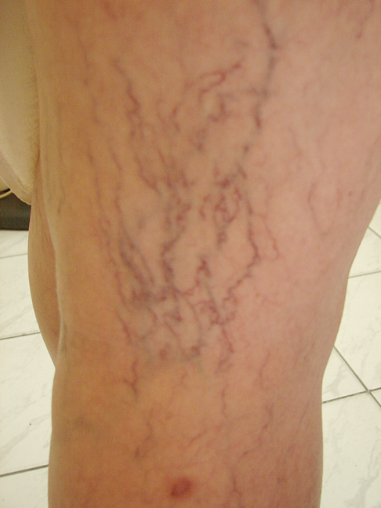
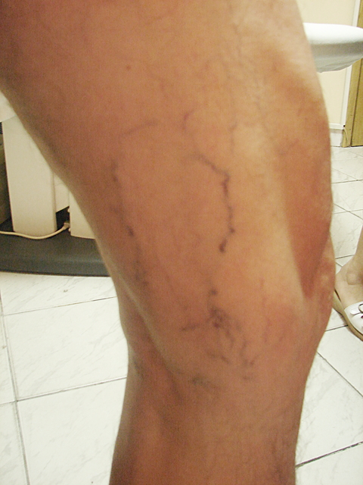
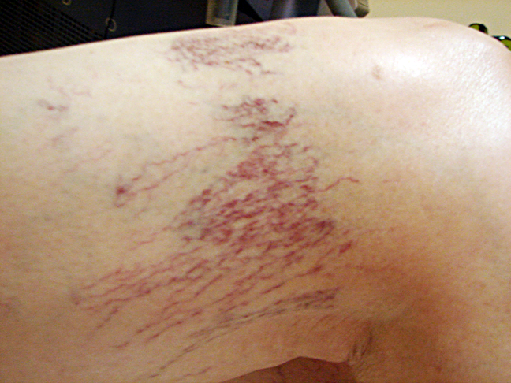
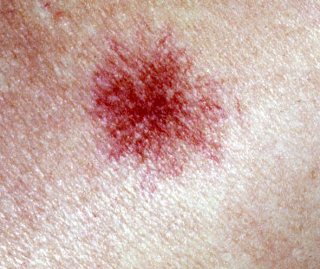

Slide 22
Reticular veins
Subcutaneous dilated veins-enter tributaries of main axial/trunk veins
Size >spider veins (1-3mm)
<varicose vein
“feeder veins”-
refluxing reticular veins spider veins
Cause discomfort and is cosmetically undesirable

Slide 23
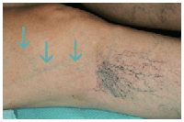

Slide 24
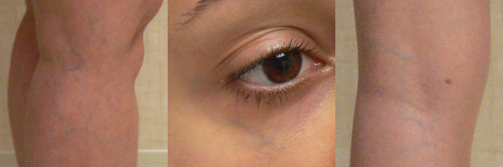

Slide 25
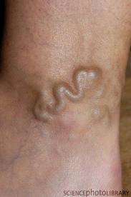
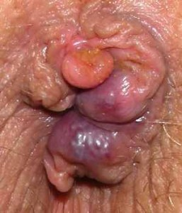
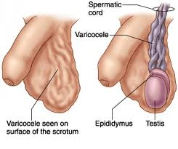
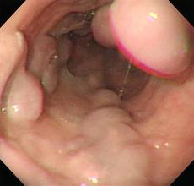
Varicose veins
Dilated,tortuous and elongated veins with reversal of blood flow mainly due to valvular incompetence
Only in humans
Includes
varicose veins in legs
Hemorrhoids
Varicocele
Oesophageal varices

Slide 26
Risk factors
Age
Gender
Height
left>right
Heredity
Pregnancy
Obesity and overweight
Posture

Slide 27
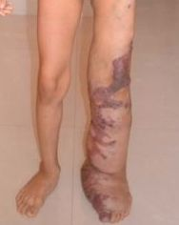
Aetiology
More common in lower limb due to erect posture
Primary varicosities
Congenital incompetence/absence of valves
Weakness or wasting of muscles
Stretching of deep fascia
Inheritance with FOXC2 gene
Klippel-trenaunay syndrome

Slide 28
Secondary varicosities
recurrent thrombophlebitis
Occupational
Obstruction to venous return
Pregnancy
Iatrogenic-in AV fistula
Deep vein thrombosis

Slide 29
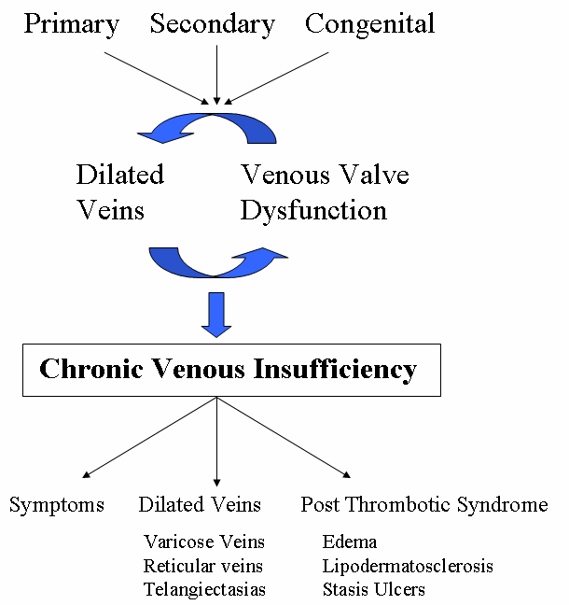

Slide 30
Symptoms
Dilated tortuous veins
Dragging pain worsening on prolonged standing/sitting
Bursting pain on walking
Swelling of the ankle
Ithcing,oedema,thickening.eczema of feet
Night cramps
Appearance of spider veins in affected leg.
Discoloration/ulceration
Skin above ankle may shrink (lipodermatosclerosis) b/c fat underneath skin becomes hard.
Bleeding blow outs
Local gigantism

Slide 31
Signs
Special tests-positive
Superficial thrombophlebitis
Ankle flare
Spider veins
Reticular veins
Saphena varix
Talipes equino varus
Champagne bottle sign
Atrophic blanche

Slide 32
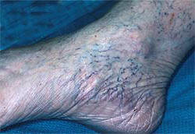
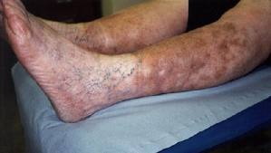
Ankle flare

Slide 33
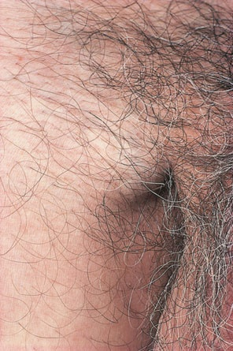
Saphena varix
A saphena varix is a dilatation at the top of the long saphenous vein due to valvular incompetence. It may reach the size of a golf ball or larger.
The varix is:
soft and compressible
disappears immediately on lying down
exhibits an expansile cough impulse
demonstrates a fluid thrill

Slide 34
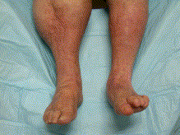
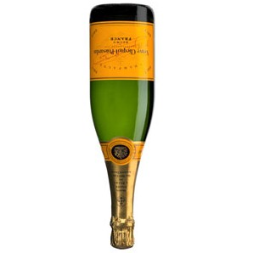
Champagne bottle sign
Inverted beer bottle look
Contraction of ankle skin and s/c tissue with prominent edematous calf

Slide 35
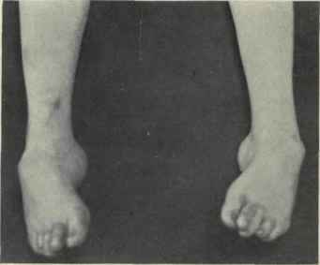
Talipes equinovarus

Slide 36
Special Tests
1. The Trendelenburg test
  Used to assess the competence of SFJ
  Patient lies flat
  Elevate the leg and gently empty the veins
  Palpate the SFJ and ask the patient to stand whilst maintaining pressure
  Findings:
  Rapid filling after thumb released→ SFJ is incompetent
  Filling from below upwards without releasing thumb →presence of distal incompetent perforators

Slide 37
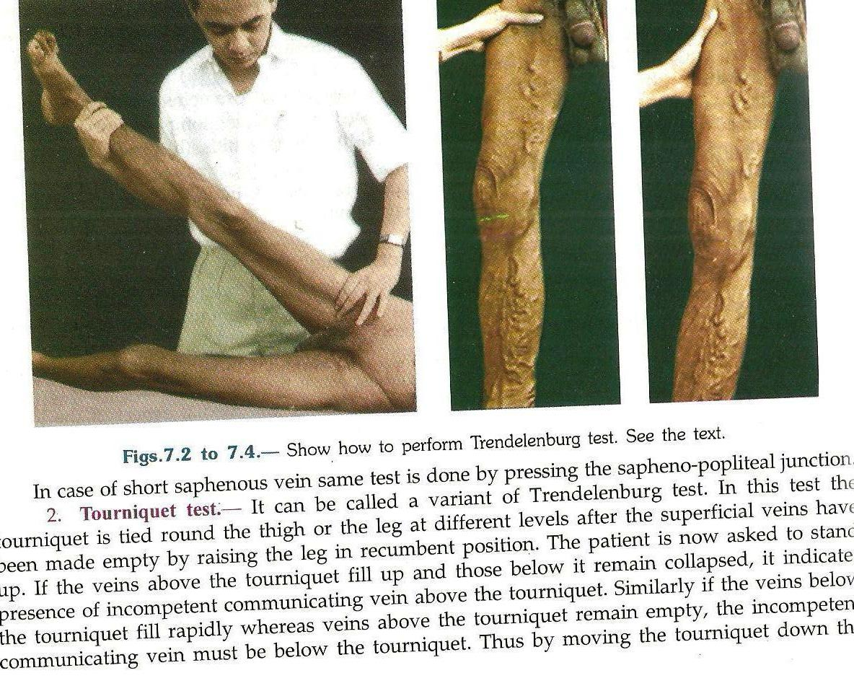

Slide 38
2. Tourniquet test
  Uses a tourniquet to control the junction rather than fingers
  Advantage of moving the tourniquet lower (mid-thigh region)
  Test is unreliable below the knee
3. Perthes Test
      Empty the vein as above, place a tourniquet around the thigh, stand the patient up.
      Ask them to rapidly stand up and down on their toes – filling of the veins indicated deep venous incompetence. This is a painful and rarely used test.
4. Schwartz test
      In standing position,tap the lower part of vein
      Impulse felt on saphenofemoral junction

Slide 39
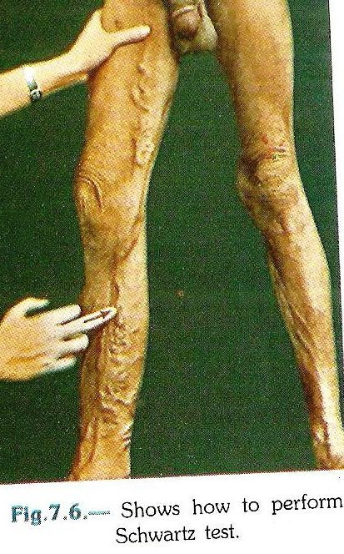
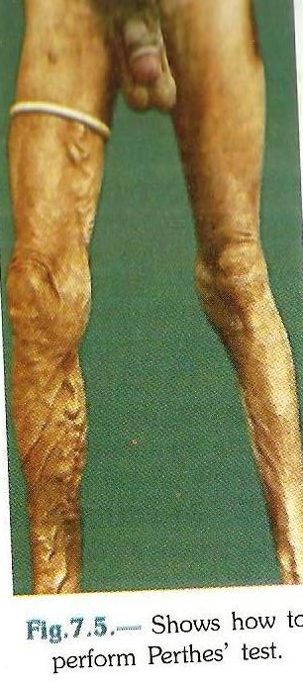
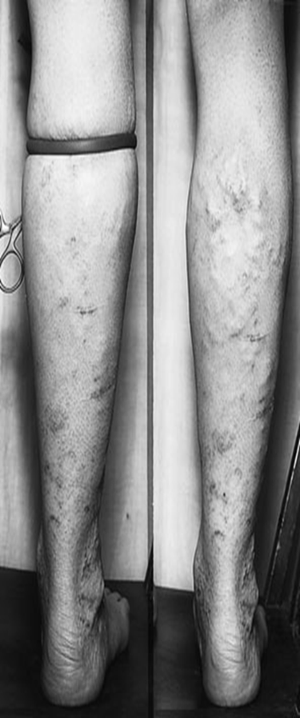

Slide 40
5.Pratt’s test-
Esmarch bandage applied on the leg from below upward with tourniquet on saphenofemoral junction
Release of bandages
Perforators seen as blow outs
6.Morrissey’s cough impulse test
limb elevated and veins emptied
Patient is asked to cough
Expansile impulse in saphenofemoral junction
7.Fegan’s test
Line of varicosities marked
Site where perforators pierce deep fascia-bulges on standing
circular depressions on lying

Slide 41
Complications
Hemorrhage
Ulcerations
phlebitis
Pigmentations
Eczema
lipodermatosclerosis
Periostitis
Calcification of vein
Equinus deformity
Acute fat necrosis can occur, esp: at ankle
Deep vein thrombosis

Slide 42
Reasons for complications
Fibrin cuff theory
valvular incompetence venous stasis
c/c ambulatory venous hypertension
Defective micro circulation Excessive RBC lysis eczema
Excessive release of hemosiderin and fibrin
Pigmentation,dermatitis and lipodermatosclerosis
capillary endothelial damage lack of exchange of nutrients
Anoxia
ULCER

Slide 43
2.WBC TRAPPING THEORY
Raised venous pressure reduced capillary perfusion trapping of WBC
Venous hypertension expression of leucocyte adhesion molecules
adhesion of WBC to capillary endothelial cells
release of proteolytic enzymes and free radicals
Endothelial damage, tissue destruction, local ischemia

Slide 44
Varicose ulcer
During recanalization of varicose veins or DVT
Most common in medial malleolus
Gaiter’s zone-handbreadth area around ankle where varicose ulcerations occur
Ulcer-shallow,flat
edge-sloping,pale blue
slope-filled with pink granulation tissue
c/c ulcer-edge-ragged
floor-fibrous
seropurulent discharge with trace of blood
surrounding skin-induration,tenderness,pigmentation
Rarely proceed to scarring,ankylosis,malignancy-Marjolin’s ulcer

Slide 45
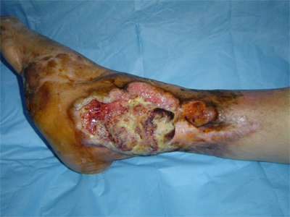
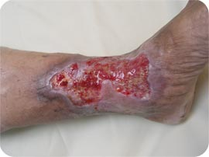
VARICOSE ULCER MARJOLIN’S ULCER

Slide 46
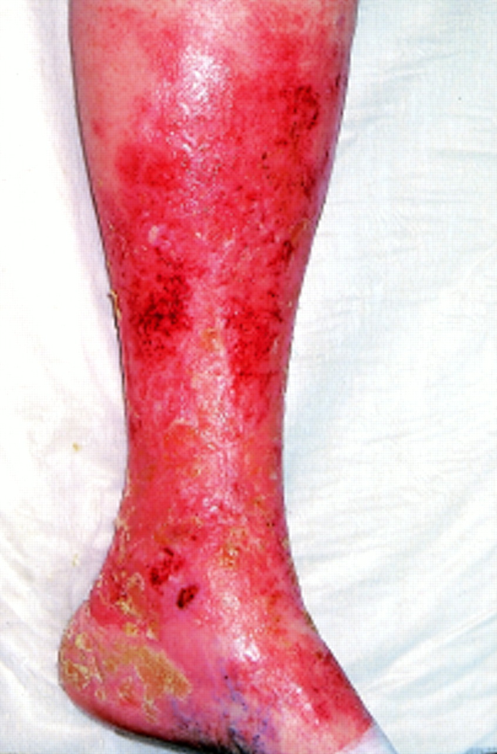
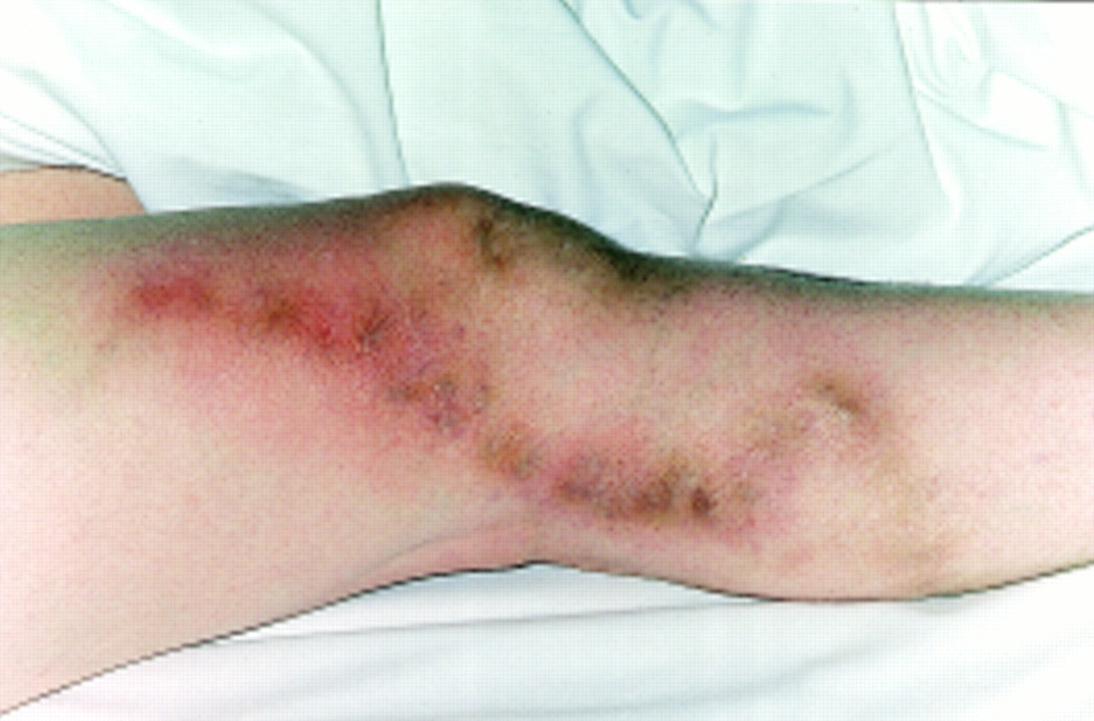
Thrombophlebitis
Thrombosis with infammation of superfiacial veins
Occur spontaneously/due to minor trauma
Can occur durin injection of sclerosing fluid for treatment

Slide 47
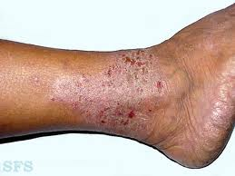
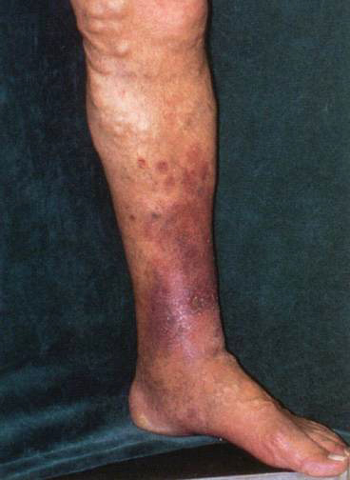
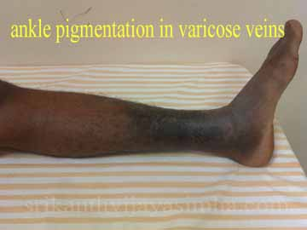
Eczema in varicose vein
lipodermatosclerosis

Slide 48
Classiffication-CEAP
C. (Clinical class):
- Class 0: No visible or palpable signs of
venous disease.
- Class I : Telangiectasis or reticular veins.
- Class 2: Varicose veins.
- Class 3: Edema.
- Class 4: Skin changes e.g. venous eczema,
pigmentation and lipodermatosclerosis.
- Class 5: Skin changes with healed ulceration
- Class 6: Skin changes with active ulceration

Slide 49
E. (Etiology):
Congenital.
Primary (undetermined cause).
Secondary:- Post-thrombotic - Post-traumatic
A. (Anatomic distribution of veins):
Superficial.
Perforator.
Deep.
P. (Pathophysiologicmechanism):
Reflux.
Obstruction.
Reflux and obstruction.

Slide 50
Investigations
Venous doppler
Duplex scan
Venography/phlebography
Plethysmography
AVP-ambulatory venous pressure
Varicography
Arm foot venous pressure
Routine investigations

Slide 51
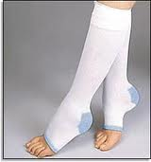
Management
Conservative treatment
Elevation of limb
Support hosiery-elastic crepe bandage /unna boots
drugs-dioxmin,toxerutin
Injection-sclerotherapy(FEGAN’S TECHNIQUE)
Injecting sclerosants into vein –sodium tetradecyl sulphate
destruction of lipid membranes of endothelial cells
shedding of endothelial cells
thrombosis,fibrosis,obliteration of veins

Slide 52
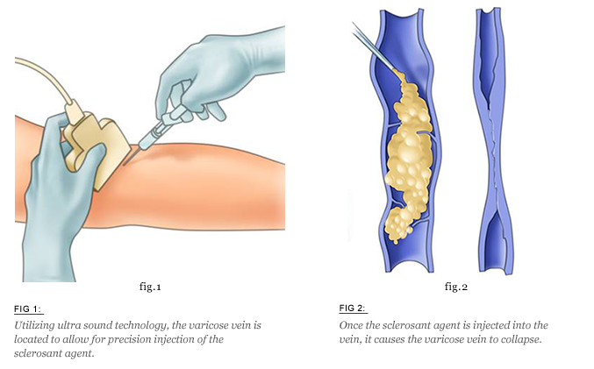

Slide 53
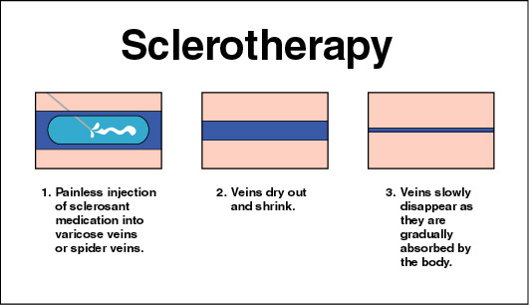

Slide 54
Surgical treatment- Trendelenburg procedure
(High tie and strip)
High saphenous ligation
Long saphenous strip
Avulsion of varicosities-multiple ligation

Slide 55
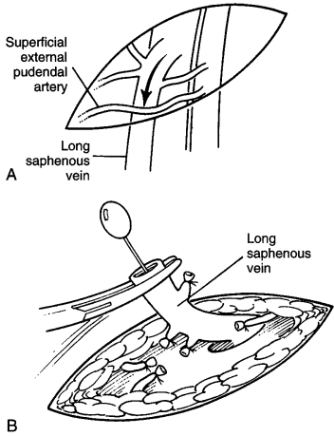

Slide 56
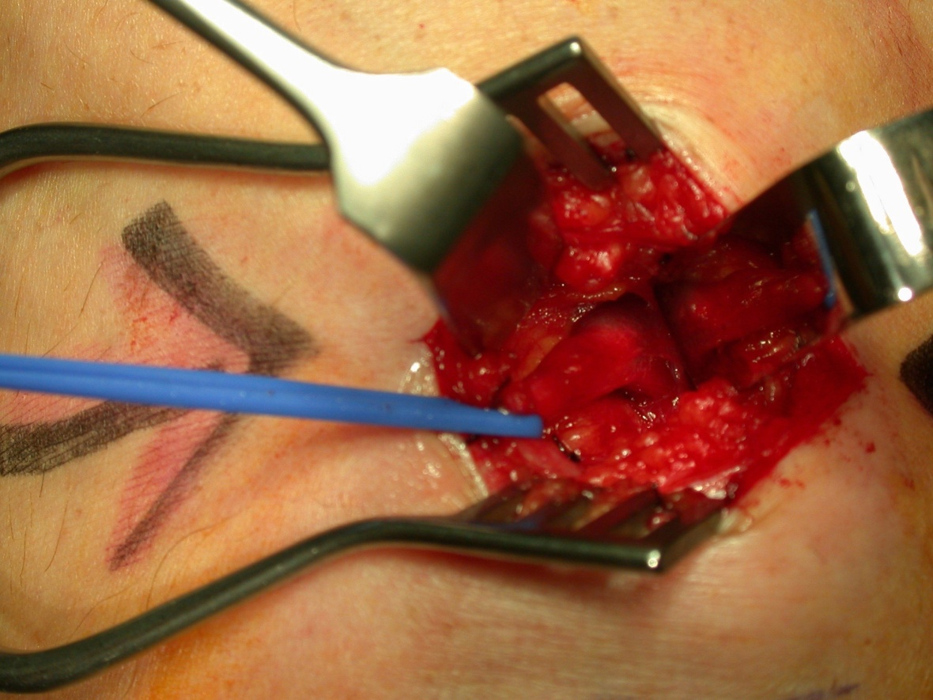
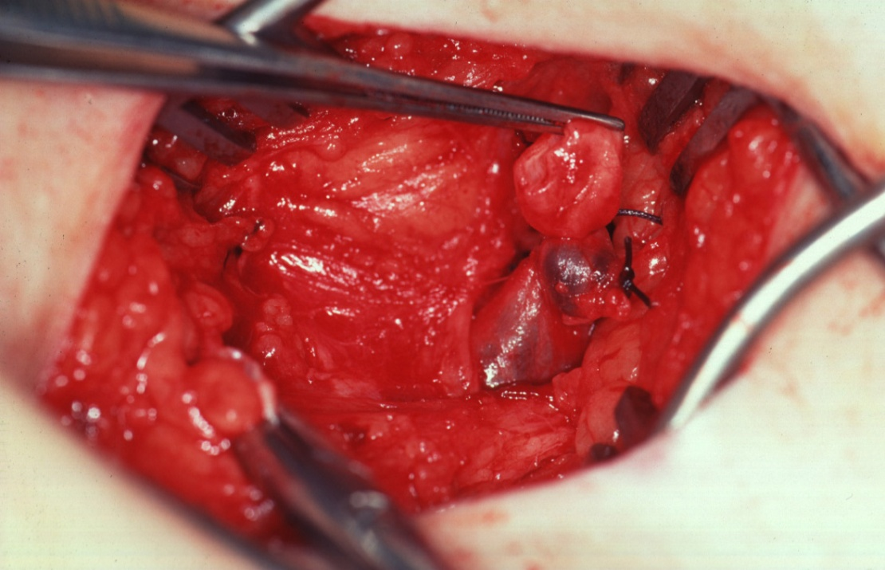
Images: Mr Neeraj Bhasin

Slide 57
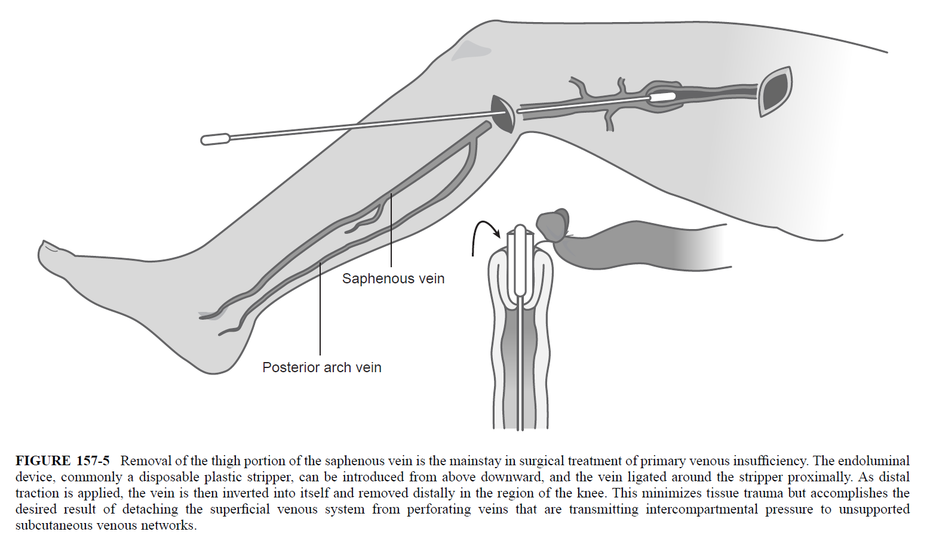

Slide 58
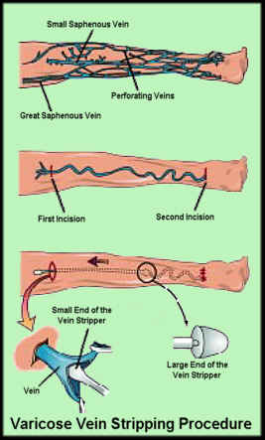

Slide 59
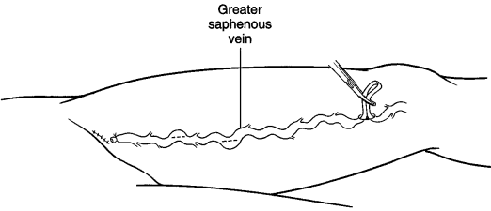

Slide 60

Endovascular occlusion of Saphenous veins using VNUS ClosureTM Catheter
A Minimally Invasive Alternative to Vein Stripping Surgery

Slide 61


